Slide 1
Build your stack with Scapy
For Fun and Profit

Slide 2
Disclaimer
We do not pretend to know everything about the topics discussed in this workshop. If you happen to know that we are for a fact wrong about something, don’t just sit there quietly, SPEAK UP.
If you have a question about anything discussed in this workshop, SPEAK UP. There are no stupid or dumb questions. Odds are, the smart looking person next to you is more lost than you are. SPEAK UP, and ask those questions!
We won’t get mad at ya for doing so. We might even buy you a beer!

Slide 3
ping stryngs
ping Jack64
Does AppSec stuff for Checkmarx (2016-)
Cobalt Core Researcher
3+ years experience in infosec
UAV operator USMC
Linux since 2006
Information Assurance – 4+ Years
<3 802.11

Slide 4
nmap workshop -vvv
tmux/Screen
iPython
Primer on 802.11
Primer on TCP
Scapy
Auth/assc
kSnarf
Out of Band communications
airpwn-ng
pyDot11
Utils (pcap-geolocate, port-knocking backdoor)
Comments / Questions / Tomato throwing session

Slide 5
Primer Questions
Q: How many of you know what a raw HTTP GET looks like?

Slide 6
Primer Questions
Q: How many of you know what a raw HTTP GET looks like?
Q: How many of you know how TCP/IP works?

Slide 7
Primer Questions
Q: How many of you know what a raw HTTP GET looks like?
Q: How many of you know how TCP/IP works?
Q: How many or you have played with raw packets before?

Slide 8
Primer Questions
Q: How many of you know what a raw HTTP GET looks like?
Q: How many of you know how TCP/IP works?
Q: How many or you have played with raw packets before?
Q: How many of you are comfortable in python?

Slide 9
Primer Questions
Q: How many of you know what a raw HTTP GET looks like?
Q: How many of you know how TCP/IP works?
Q: How many or you have played with raw packets before?
Q: How many of you are comfortable in python?
Q: How many of you are blue teamers?

Slide 10
Primer Questions
Q: How many of you know what a raw HTTP GET looks like?
Q: How many of you know how TCP/IP works?
Q: How many or you have played with raw packets before?
Q: How many of you are comfortable in python?
Q: How many of you are blue teamers?
Q: How many of you are red teamers?

Slide 11
tmux / Screen
Used as a terminal multiplexer
Allows you to re-ssh without nohup nonsense
Essential for headless
Saves real-estate
Scapy wants shells.

Slide 12
IPython
ncurses based
We don’t need no stinkin GUI
Tab it out
?
When used with Scapy
Endless results
Severe happiness
Pwnage

Slide 13
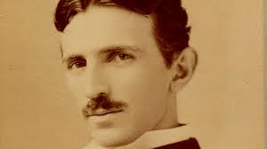
802.11
Radio waves are all around us
Works off the concept of “Shared Medium”
All we have to do, is listen
Can’t hide from me….

Slide 14
Useful 802.11 Acronyms
Authenticator: An entity at one end of a point-to-point LAN segment that facilitates authentication of the entity attached to the other end of that link. (IEEE Std 802.1X-2004)
BSSID: Basic Service Set Identifier. Commonly known as the MAC address of a specific Access Point.
Distribution system (DS): A system used to interconnect a set of basic service sets (BSSs) and integrated local area networks (LANs) to create an extended service set (ESS).
ESSID: Extended Service Set Identifier. Commonly referred to as the SSID and known by the masses as the “Network Name”.

Slide 15
Useful 802.11 Acronyms
Group Temporal Key (GTK): A random value, assigned by the group source, which is used to protect group addressed medium access control (MAC) protocol data units (MPDUs) from that source. The GTK might be derived from a group master key (GMK).
Medium Access Control (MAC) Protocol Data Unit (MPDU): The unit of data exchanged between two peer MAC entities using the services of the physical layer (PHY).
Pairwise Master Key (PMK): The key derived from a key generated by an Extensible Authentication Protocol (EAP) method or obtained directly from a preshared key (PSK).
Pairwise Transient Key (PTK): A concatenation of session keys derived from the pairwise master key (PMK) or from the PMK-R1. Its components include a key confirmation key (KCK), a key encryption key (KEK), and one or more temporal keys that are used to protect information exchanged over the link.

Slide 16
Useful 802.11 Acronyms
Station (STA): A logical entity that is a single addressable instance of a medium access control (MAC) and physical layer (PHY) interface to the wireless medium (WM).
Supplicant: An entity at one end of a point-to-point LAN segment that is being authenticated by an Authenticator attached to the other end of that link. (IEEE Std 802.1X-2004)

Slide 17
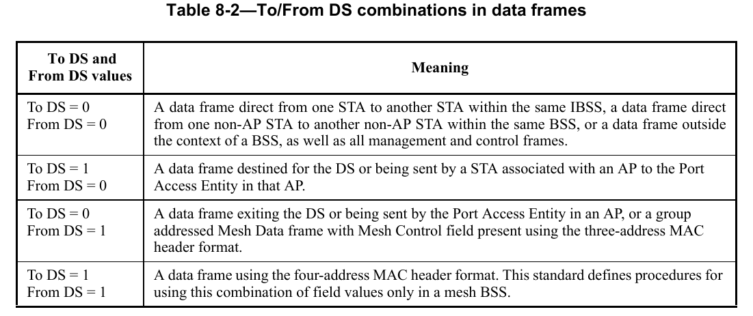
From-DS and To-DS

Slide 18
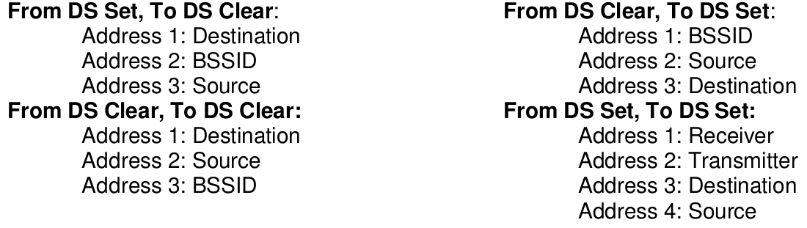
Address Fields

Slide 19
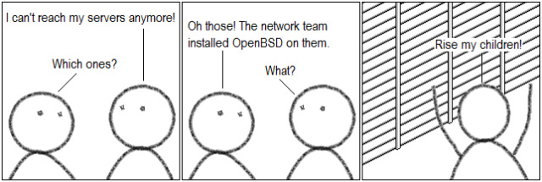
Crazy Memory Time
Remember To First
‘Tis better TO give than to receive
Next remember BSD
That crazy operating system TO give to your friends
BSSID
SOURCE
DESTINATION
To-DS

Slide 20

Crazy Memory Time
Smart people use Databases (DBS), not Excel
Excel Sucks
Destination
BSSID
Source
From-DS

Slide 21
Crazy Memory Time
Learn your Scapy Decimals for Direction
1 - To-DS
2 - From-DS
65 - To-DS (with Encryption)
66 - From-DS (with Encryption)

Slide 22
Crazy Memory Time
Learn your Scapy Decimals for Type
0 - Management
1 - Control
2 - Data
“First you have to Manage, then you can Control the Data”

Slide 23
Crazy Memory Time
All of this corresponds to the Dot11 Class
FCfield
addr1
addr2
addr3
type
Learn how to manipulate and interpret the above
The world is your oyster

Slide 24
TCP
What do you think of when you hear TCP-IP?

Slide 25
TCP
What do you think of when you hear TCP-IP?
syn , syn/ack, ack
FIN, PSH, URG

Slide 26
TCP
What do you think of when you hear TCP-IP?
syn , syn/ack, ack
FIN, PSH, URG
How do you attack TCP?

Slide 27
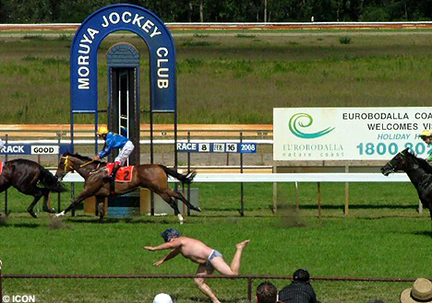
TCP
What do you think of when you hear TCP-IP?
syn , syn/ack, ack
FIN, PSH, URG
How do you attack TCP?
Sequence and Acknowledgement numbers
First horse across the finish line, wins

Slide 28
TCP
What do you think of when you hear TCP-IP?
syn , syn/ack, ack
FIN, PSH, URG
How do you attack TCP?
Sequence and Acknowledgement numbers
First horse across the finish line, wins
If you remember nothing else

Slide 29

TCP
What do you think of when you hear TCP-IP?
syn , syn/ack, ack
FIN, PSH, URG
How do you attack TCP?
Sequence and Acknowledgement numbers
First horse across the finish line, wins
If you remember nothing else
Sequence + Length == Acknowledgement
This is your 42

Slide 30


TCP Flags
less

Slide 31
TCP Flags
FIN – No more data from sender (Seen after a connection is closed)
URG – indicates that the URGent pointer field is significant
CWR – Congestion Window Reduced (CWR) flag is set by the sending host to indicate that it received a TCP segment with the ECE flag set (added to header by RFC 3168).
ACK – indicates that the ACKnowledgment field is significant (Sometimes abbreviated by tcpdump as ".")
SYN – Synchronize sequence numbers (Seen on new connections)
PSH – Push function
ECE (ECN-Echo) – indicate that the TCP peer is ECN capable during 3-way handshake (added to header by RFC 3168).
RST – Reset the connection (Seen on rejected connections)

Slide 32


TCP #s
-VS-

Slide 33
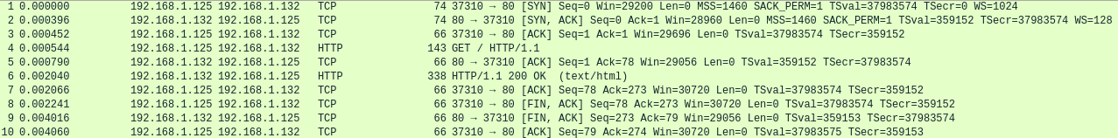
TCP #s
-VS-

Slide 34

TCP #s

Slide 35

Coooookies!
HTTP is stateless
Cookies create a bridge for this purpose
Have the cookie == Access
Mostly…
Demo

Slide 36
Scapy
Created by Philippe Biondi
Best damn interactive packet manipulator, ever.
Who here has used?

Slide 37
Scapy tidbits
Namespace overwrite warning…
ls()
lsc()
pkt.show()
rdpcap()/wrpcap()
PcapReader()/PcapWriter()
hexstr
str
send()/sendp()
prn
Closure example
lfilter

Slide 38

Learning to fly
sendp() and send() only “work” if the tgt gets a packet it expects
Garbage in, Garbage out
So, how do we build?
We could learn by reading the RFC and building the packet from scratch…
OR:
We use a pre-existing packet/frame from a PCAP!
Take the pre-existing packet, and reverse engineer it
World domination follows shortly

Slide 39

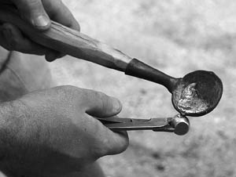
This is my Rifle
We now know how to listen
We wait for the trigger, then pull

Slide 40
Out-of-Band Communications Channel
Problem: How to exfiltrate data from:
A) Airgapped systems or networks (no internet connection)?
B) system with highly monitored or restricted internet access (DPI, egress filtering, etc)?

Slide 41
Out-of-Band Communications Channel
Answer: Use custom 802.11 frames!

Slide 42
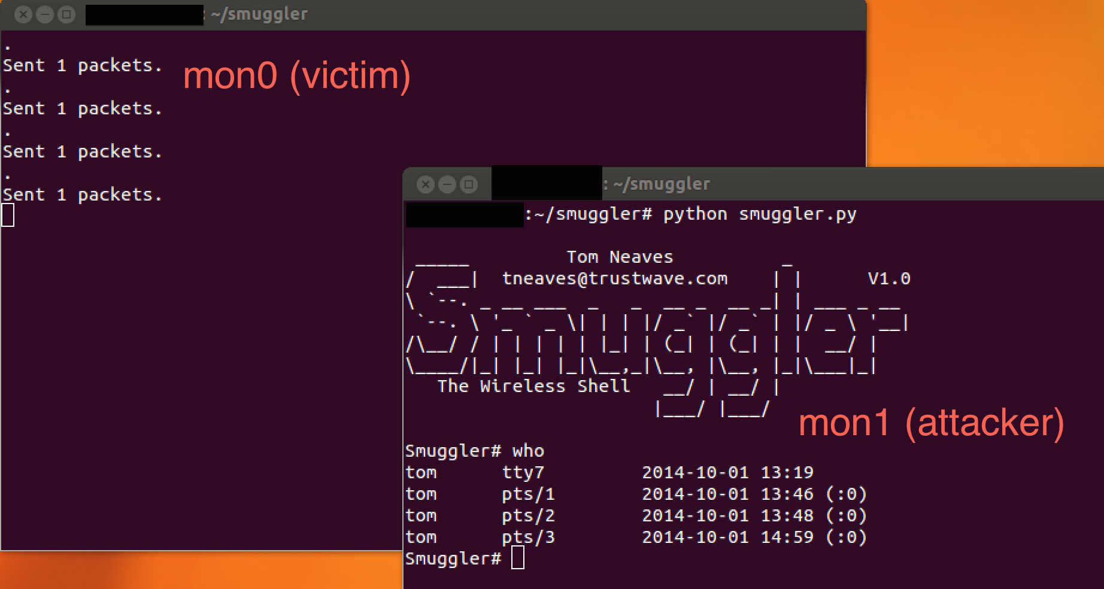
Out-of-Band Communications Channel

Slide 43
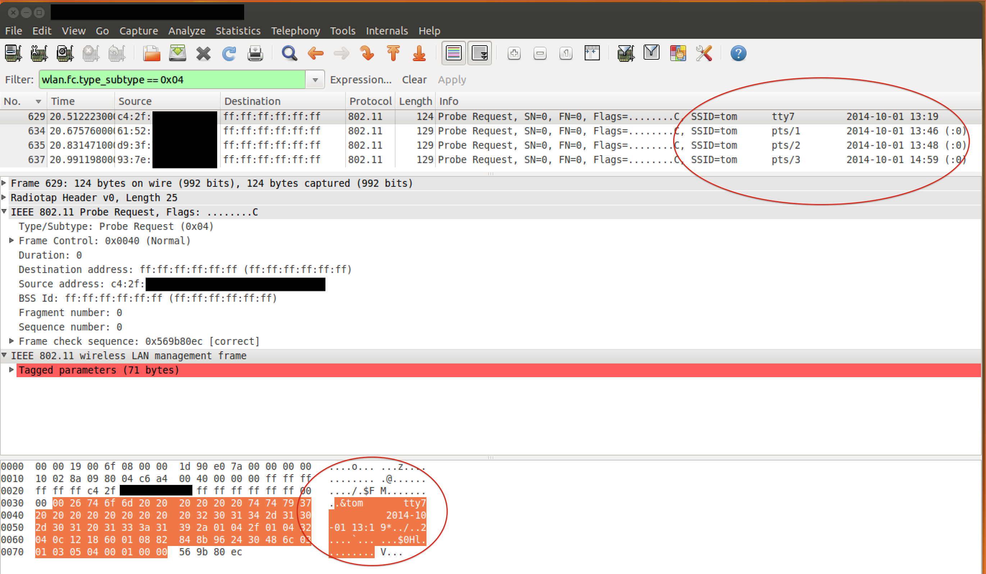
Out-of-Band Communications Channel

Slide 44
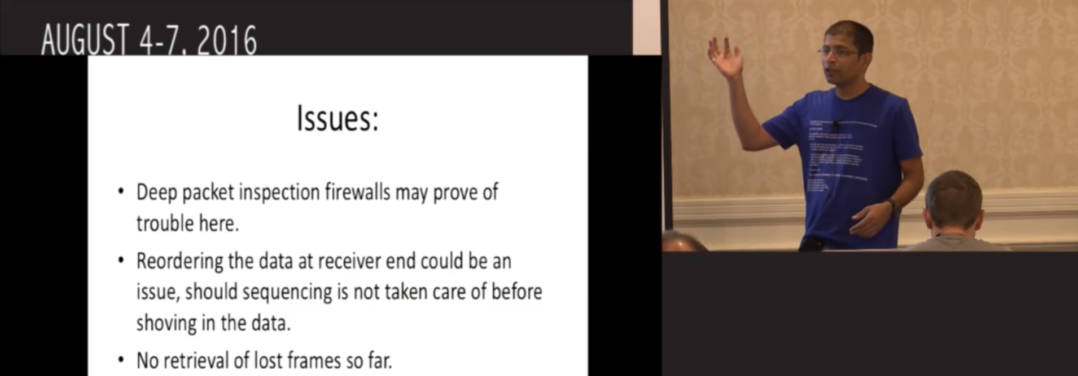
Out-of-Band Communications Channel

Slide 45
Out-of-Band Communications Channel
Writing a detector for Smuggler/Covert Cupid/Chura-Liya:
Beacon frames with SSID field larger than 32 bytes
Probe Requests with Rates field larger than 32 bytes
Regex search for common unix words (root, bash, etc)

Slide 46
Out-of-Band Communications Channel
A different approach - Use 802.11 Data Packets

Slide 47

Out-of-Band Communications Channel

Slide 48
Out-of-Band Communications Channel
Detecting OOBackdoor
Protocol limitations
Work-in-Progress

Slide 49
Scapy Utils

Slide 50
Geolocate-pcap.py

Slide 51
Port-Knocking Backdoor

Slide 52
airpwn-ng
Conceptualized from the original airpwn by t0ast
POC in bash
Remastered in Python
Why does it work?
1st to the finish line of course…

Slide 53
airpwn-ng
Open wifi simple concept demonstration
This is our fastest example as no encryption needed

Slide 54
pyDot11
On-the-fly encryption and decryption of 802.11
WEP or WPA
CCMP only right now, no TKIP…
Created because stryngs could not find any other tool like it
airventriloquist-ng...
Learned, so much
Passion and devotion pays off.
Eventually will be scrapped in favor of airventriloquist-ng as a .so for Python

Slide 55
airpwn-ng
Encrypted wifi demo

Slide 56
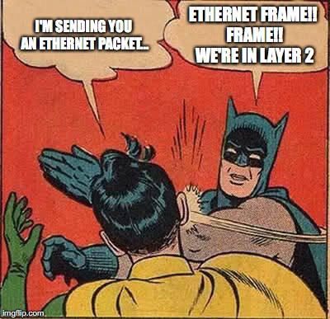
Questions?
Notes:
5

